Slide 1

Estimating Action
Notes:
1

Slide 2
Objectives
Understand action value and how to estimate the action value
Learn some methods to estimate action value
Estimating Action
2
Notes:
2

Slide 3
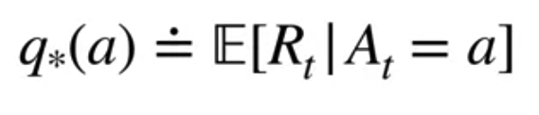
Value of an Action
The value of an action is the expected reward when that action is taken
The action value q is not know → we estimate it !
Imaging that you have k action, how do you calculate the action value?
3
Estimating Action
Notes:
3

Slide 4
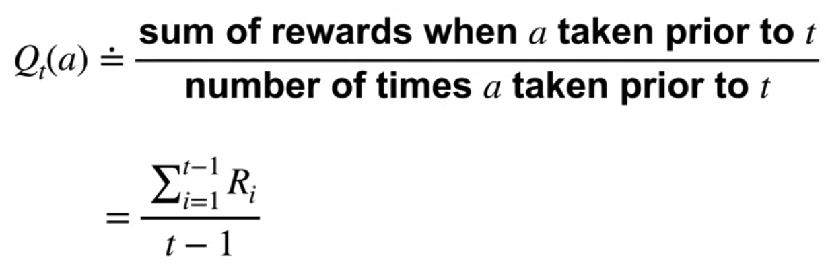
Value of an Action
Sample- Average method
The total reward for each action and divide it by the number of times that action has been selected.
4
Estimating Action
Notes:
4

Slide 5
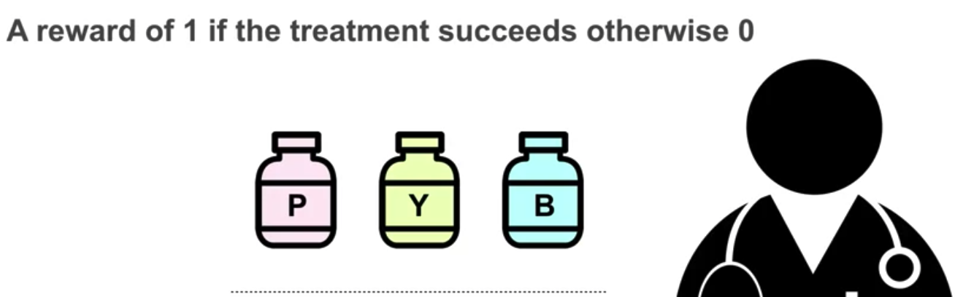
Value of an Action
Example- Clinical trials: A doctor must decide which of the three possible treatments to prescribe. If the patient gets better, the doctor records a reward of one. Otherwise, the doctor records a reward of zero.
5
Estimating Action
Notes:
5

Slide 6
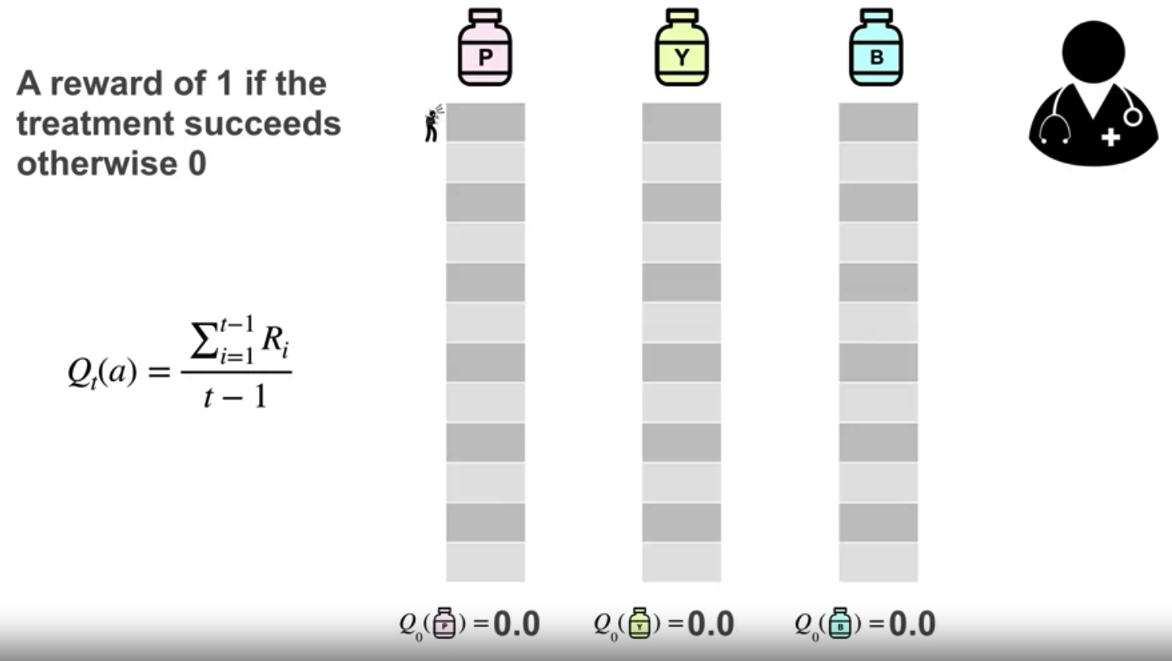
Value of an Action
First action value for all treatment is zero
6
Estimating Action
Notes:
6

Slide 7
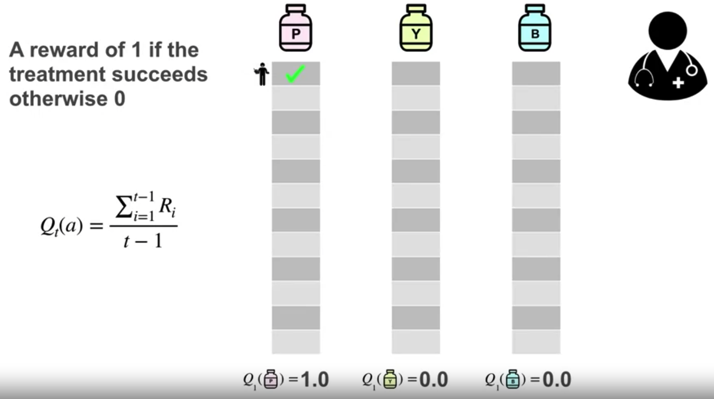
Value of an Action
The patient reports feeling better. The doctor records a reward of one for that treatment and updates the estimate of the value.
7
Estimating Action
Notes:
7

Slide 8
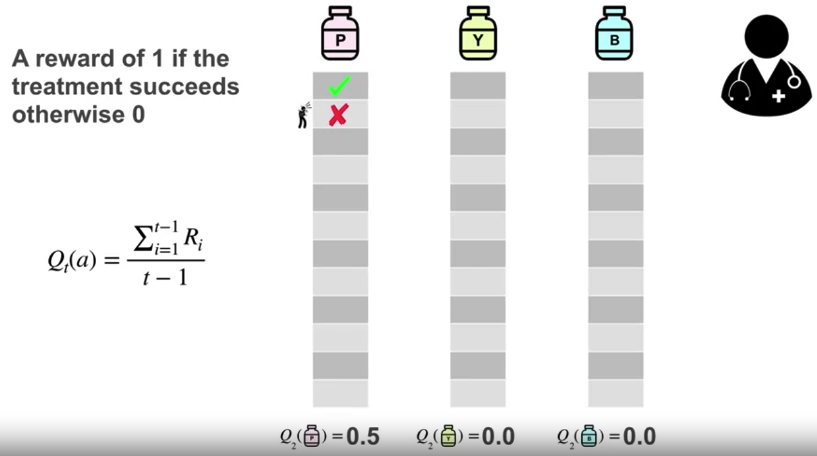
Value of an Action
Second patient: The doctor randomly prescribes treatment P again. It fails, the doctor records and rewards zero, and updates the value estimate for treatment P to 0.5
8
Estimating Action
Notes:
8

Slide 9
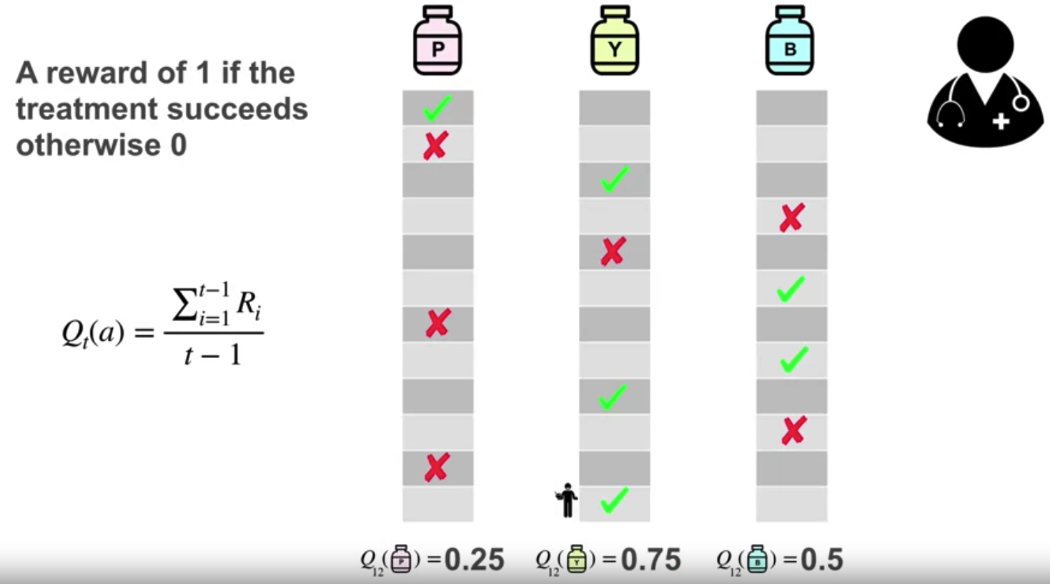
Value of an Action
After each treatment has been tried a few times, we can calculate the estimated values from the observed data. As the doctor observes more patients, the estimates approach the true action values.
9
Estimating Action
Notes:
9

Slide 10
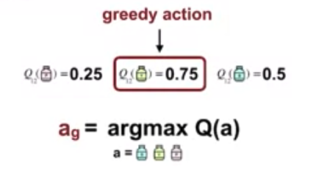
Value of an Action
Greedy method:
The greedy action is the action that currently has the largest estimated value. Selecting the greedy action means the agent is exploiting its current knowledge.
10
Estimating Action
Notes:
10

Slide 11
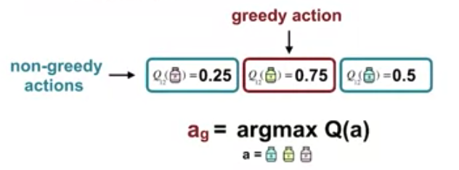
Value of an Action
Alternatively, the agent may choose to explore by choosing a non-greedy action. The agent would sacrifice immediate reward hoping to gain more information about the other actions.
11
Estimating Action
Notes:
11

Slide 12
Summary
Understand action value and how to estimate the action value
Learn some methods to estimate action value
Estimating Action
12

Slide 13
Q & A
Estimating Action
13

